Slide 1
Human resources slide 1
Automatic Drug Dispenser
Organisation Name : AICTE MIC – Student
Innovation
PS ID : SIH1479
Team Name : NovaCode
Institute Name
School of Engineering,
Avinashilingam Institute for Home Science and Higher Education for Women

Slide 2
Human resources slide 2
AGENDA
Overview
Statistics
Components
Flowchart
Conclusion

Slide 3
Human resources slide 9
Overview
Today the continuous healthcare monitoring of elderly people needs a great amount of money to spend towards the caretakers to increase the life span of them.
To provide care and increase the lifespan of elderly people an Automatic Drug Dispenser is needly one.
Elderly people can independently take medicines at prescribed time and reduces the mishandling of drugs such as skipping doses, ingesting the improper dosages, or taking medications at the wrong time .
Dispensing pills using Raspberry pi, Biometrics, Sensors , Dispenser etc.,
Send the notifications to caregivers or next of kin based on the regularity of medicine consumption .

Slide 4

Human resources slide 3
Statistics
EMPLOYEES ARE MOTIVATED BY:
Overall percentage of disability
4.5%
People with Alzeimers
50%
Percentage of elderly disabled with caregivers
61%
Percentage of elderly disabled without caregivers
37%

Slide 5
Human resources slide 4
RASBERRY PI B+(2014 MODEL)
Image Processing to detect the patient
before dispensing pills
SERVO MOTOR
ARDIUNO UNO(R3)
Driver circuit to open and shut the front end gateway for the pill
Real time clock module , buzzer and detecting pills
COMPONENTS
IR SENSOR
CAMERA
Biometrics – face detection
Detecting whether the pill is taken or not
PIEZOELECTRIC
Generate high current for charging

Slide 6
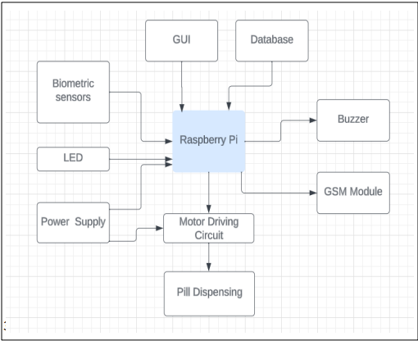
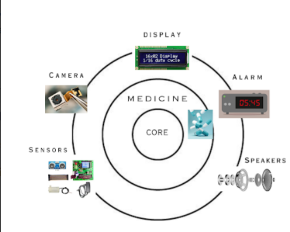
Human resources slide 5
Flowchart

Slide 7
Conclusion
The proposed device will keep track of regular medical taking activities of the elderly persons.
Also reduces manual supervision and manual effort.
Cost effective and beneficial for the elderly part of society and also aids the disabled citizens.

Slide 8

Thank you

